Slide 1
Hypertextual Prototype
Welcome view
Userlogindone view
Group view

Slide 2
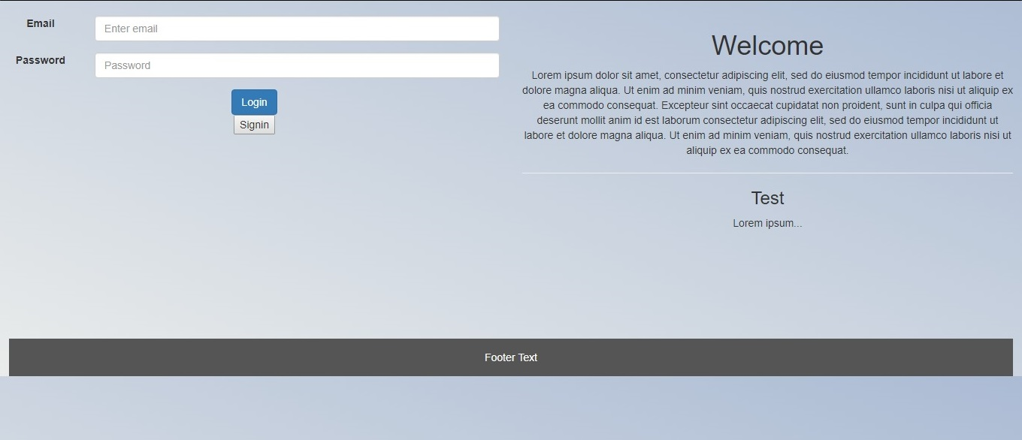

Press login button to get into user profile!
(Suppose credentials to be given!)

Slide 3
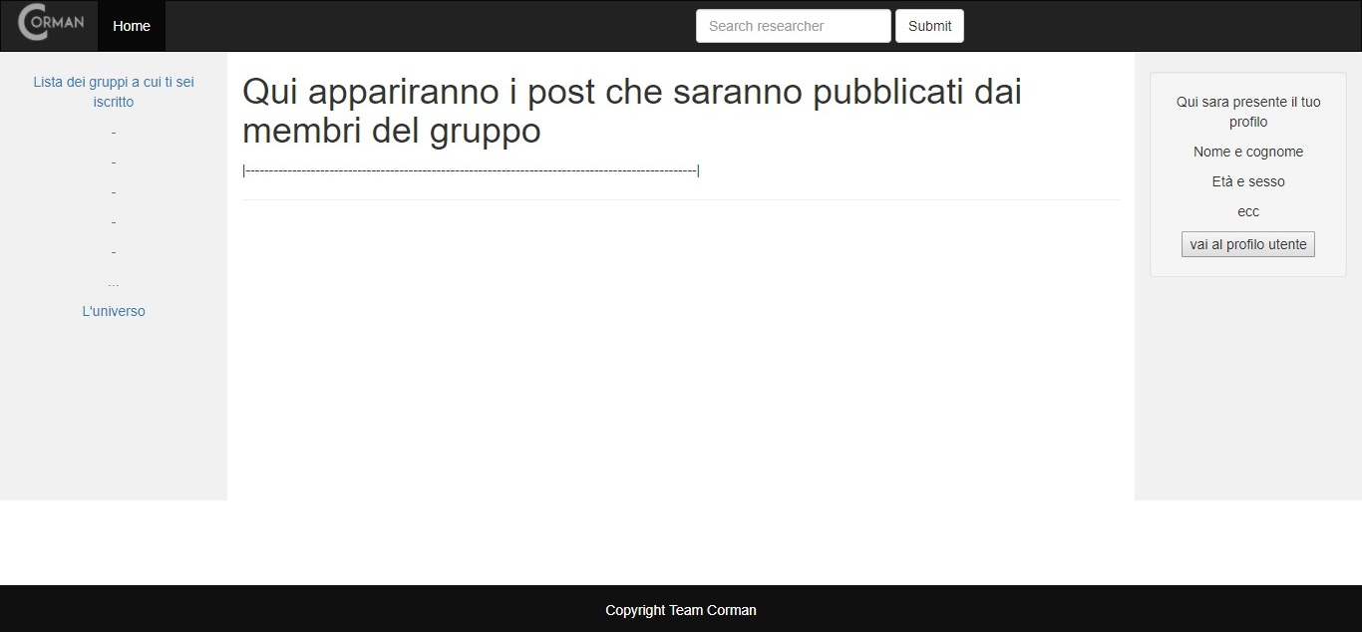

Press «Home» to get back to Welcome Page!

Slide 4
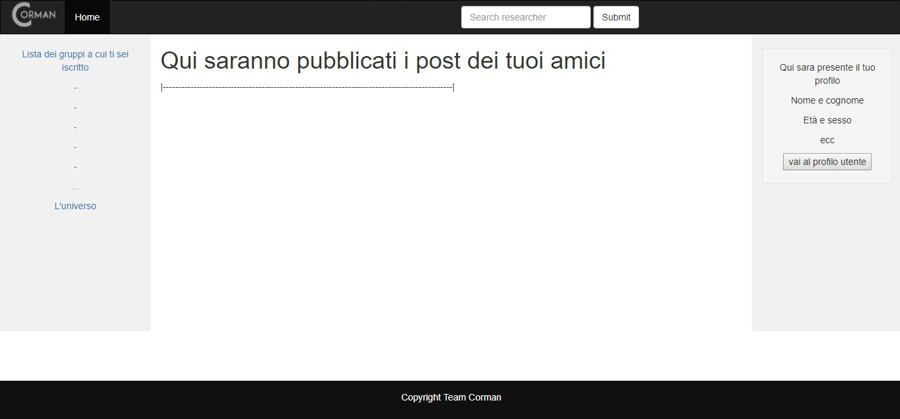
Press «Home» to get back to Welcome Page!

